Slide 1

Version Control System

Slide 2
SESSION 1
What is GIT?
Git is a Version control system.
To track the changes to our files and folders.
To collabrate in Team
Two tyes of VCS
Centralizes and Distributed.
https://git-scm.com/
Git is a free and open source distributed version control system designed to handle everything from small to very large projects with speed and efficiency.
2. What is GIT HUB
3. Is GIT related to GIT HUB
4. A simple workflow

Slide 3
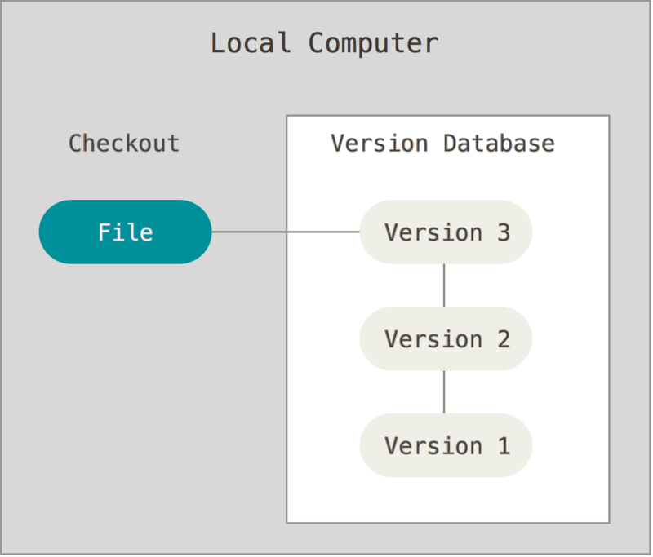
Notes:
Make any changes to the file and you can track all the changes of the file if you are maintaining any version control system.
To track changes in files and folders.
You can as well revert back and forth if you find that the changes made to the file has caused problem from the previous file.

Slide 4
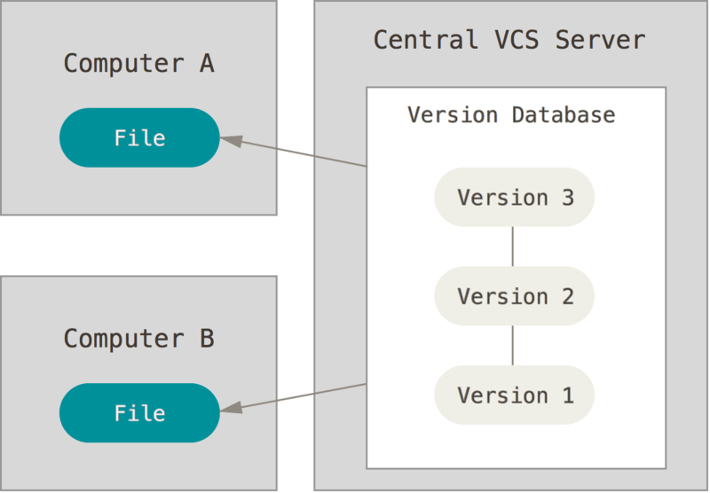
Notes:
Multiple people works of the same file.
By checksout the same file and makes changes.

Slide 5
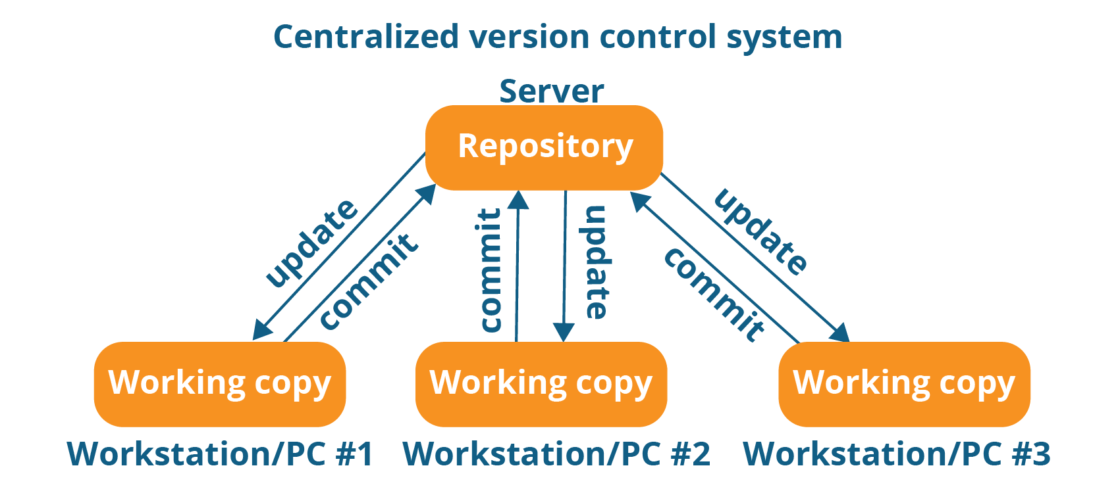
Notes:
Wrkstn 1 – 2 and 3 work on the same repository and the.
Disadvantage.
If the central repsoitory fails then the whole project is lost.
Contected always and have to be online all the time. To collaborate.

Slide 6
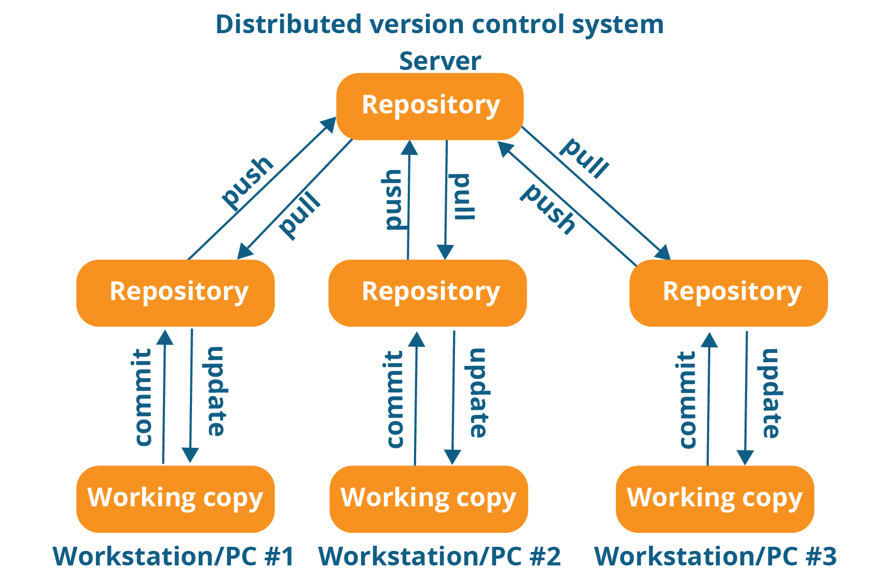
Notes:
Keep working offline
Need to be connected only when PUSH and PULL is required.

Slide 7
GIT HUB
What is GIT HUB
https://github.com/
GitHub is a development platform inspired by the way you work. From open source to business, you can host and review code, manage projects, and build software alongside millions of other developers.
- Website/remote location to upload repositories online.
- Provide Backup
- Provide Visual interface to your repo.
- Makes Collaboration easier
Is GIT related to GIT HUB
- No.
GIT is a Version Control System (VCS) and GITHUB is a website based remote location to upload your repositories.
Notes:
GIT HUB is the website to upload repo. Online. Or BITBUKET etc.

Slide 8
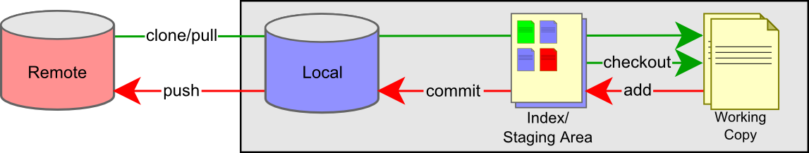
A simple workflow

Slide 9
Get Started with installing GIT
Download and Install GIT.
Signup and Create a account on GITHUB.
Add a file/folder to GIT.
Track and Commit Changes.
Add the repository on GITHUB.

Slide 10
Step 1 :
Check if git is already installed.
terminal - git --version
Step 2 :
Download and install git:https://git-scm.com/download/
$ yum install git (for linux installation)
Step 3 :
Signup and create a account on GitHub:https://github.com/
Step 4 :
Add your github email and username to git
git config --global user.email "yourGitHub@email.com"
git config --global user.name "yourGitHubusername"
Step 5 : Add file/folders to git - tracking
Step 6 : Commands
- terminal - goto the location of the folder/project - git init
- git status
- git adds .
- git commit -m “…..”
- git remote add origin “location of remote repo”
- git push -u origin master
- git log and - git --help
Notes:
References to Install GIT on Redhat/Centos and Scientific Linux
https://git-scm.com/download/linux
http://stackoverflow.com/questions/21820715/how-to-install-latest-version-of-git-on-centos-6-x-7-
https://tecadmin.net/install-git-2-x-on-centos-rhel-and-fedora/#

Slide 11
Branching and Merging
1. What are branches
2. How to create branch
3. How to checkout branch
4. How to merge branch to master
5. How to delete branch (local and remote)
_________________________________________
Step 1 : Create branch
git branch “branch name”
Step 2 : Checkout branch
git checkout “branch name”
Make changes in the “branch” and follow [git add . ] then [git commit –m “xxx”] then
git push –u origin “branch name” : To push the changes to the remote origin
Step 3 : Merge new branch in master branch
git merge “branch name”
git push –u origin master : To push the changes to the remote origin
Note: To do so make sure you have already checked out to master
Step 4 : Delete branch
git branch -d “branch name” — delete from local
git push origin —delete “branch name” — delete from remote

Slide 12
Forking and Pulling
A fork is a copy of a repository. Forking a repository allows you to freely experiment with changes without affecting the original project..
Propose changes to someone else's project
A great example of using forks to propose changes is for bug fixes. Rather than logging an issue for a bug you've found, you can:
Fork the repository.
Make the fix.
Submit a pull request to the project owner.
If the project owner likes your work, they might pull your fix into the original repository!
Fork an example repository
Forking a repository is a simple two-step process. We've created a repository for you to practice with!
On GitHub, navigate to the octocat/Spoon-Knife repository.
In the top-right corner of the page, click Fork.
That's it! Now, you have a fork of the original octocat/Spoon-Knife repository.

Slide 13
Forking and Pulling cont…
Step 1. Clone a FORKED repo.
Type git clone, and then paste the URL you copied. It will look like this, with your GitHub username instead of YOUR-USERNAME: $ git clone https://github.com/YOUR-USERNAME/Spoon-Knife
Step 2: Configure Git to sync your fork with the original Spoon-Knife repository
$ git remote –v OR $ git remote (will show the remote repos associated)
$ git remote add upstream https://github.com/octocat/Spoon-Knife.git
Step 3: Fetch updates from the ORIGINAL to update the FORKED.
$ git fetch upstream
Step 4: Make changes in the local Forked repo and update/push.
Make some changes.
$ git add . ; git commit –m “made changes”
$ git push origin master
The sky's the limit with the changes you can make to a fork, including:
Creating branches: Branches allow you to build new features or test out ideas without putting your main project at risk.
Opening pull requests: If you are hoping to contribute back to the original repository, you can send a request to the original author to pull your fork into their repository by submitting a pull request.
Reference: https://help.github.com/articles/fork-a-repo/

Slide 14
Tags and Tagging
Git TAGS - What | Why | When | How
What are tags / releases
Tags in git are lightweight references that point to an SHA hash of a commit. Unlike branches, they are not mutable and once created should not be deleted. Tags may be lightweight (in which case they refer to the commit directly) or annotated (in which case they point to a tag object which points to the commit).
2. Why should i create TAGs
Like most VCSs, Git has the ability to tag specific points in history as being important. Typically people use this functionality to mark release points (v1.0, and so on).
3. When to create TAGs
Typically people use this functionality to mark release points (v1.0, and so on).

Slide 15
How to create TAGs in git create | show | publish | delete
Step 1:
Checkout the branch where you want to create the tag
$git checkout "branch name"
example : git checkout master
Step 2: Two Types of TAGS (lightweight and annotated)
Create tag with some name
$git tag "tag name"
example : git tag v1.0
$git tag -a v1.0 -m "ver 1 of .." (to create annotated tags)
Step 3:
Display or Show tags
$git tag
$git show v1.0
$git tag -l “v1.*”
Step 4:
Push tags to remote
$git push origin v1.0
$git push origin --tags
$git push --tags
(to push all tags at once)
Step 5:
Delete tags (if required only)
To delete tags from local :
$git tag -d v1.0
$git tag --delete v1.0
To delete tags from remote :
$git push origin -d v1.0
$git push origin --delete v1.0
$git push origin :v1.0
To delete multiple tags at once:
$git tag -d v1.0 v1.1 (local)
$git push origin -d v1.0 v1.1 (remote)

Slide 16
Checking out TAGS
We cannot checkout tags in git
We can create a branch from a tag and checkout the branch
git checkout -b "branch name" "tag name"
example : git checkout -b ReleaseVer1 v1.0
Creating TAGS from past commits
git tag "tag name" "reference of commit"
example : git tag v1.2 5fcdb03
Reference: https://git-scm.com/book/en/v2/Git-Basics-Tagging

Slide 17
